Slide 1
St. Flannan's College
6th Year Parents/Guardians Information Night
Thursday, 20th October 2022
Assembly Hall @ 7.30pm

Slide 2
Deputy Principal - Ms. Grainne Lynch
Year Head Classes 6A-6E
Ms. Emer Murphy
Year Head Classes 6F - 6H
Ms. Olivia Durcan

Slide 3
Contact us
065-6828019
GRAINNE LYNCH DP
Ext 108
grainne.lynch@stflannanscollege.ie
EMER MURPHY 6A-6E
Ext 107
emer.murphy@stflannanscollege.ie
OLIVIA DURCAN 6F-6H
Ext 211
olivia.durcan@stflannanscollege.ie

Slide 4
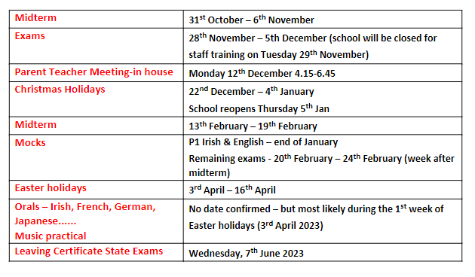
Important Dates

Slide 5
Driving policy
Any student who drives to school must register their vehicle with the Deputy Principal Ms. Grainne Lynch & sign our school policy on student driving.

Slide 6
vsware app
Any parents with issues downloading the app or accessing their password please e-mail info@stflannanscollege.ie
Please continue to input absentee notes before 8.30 am each morning if possible
Reminder that parents/guardians must sign out their son/daughter at the main office

Slide 7
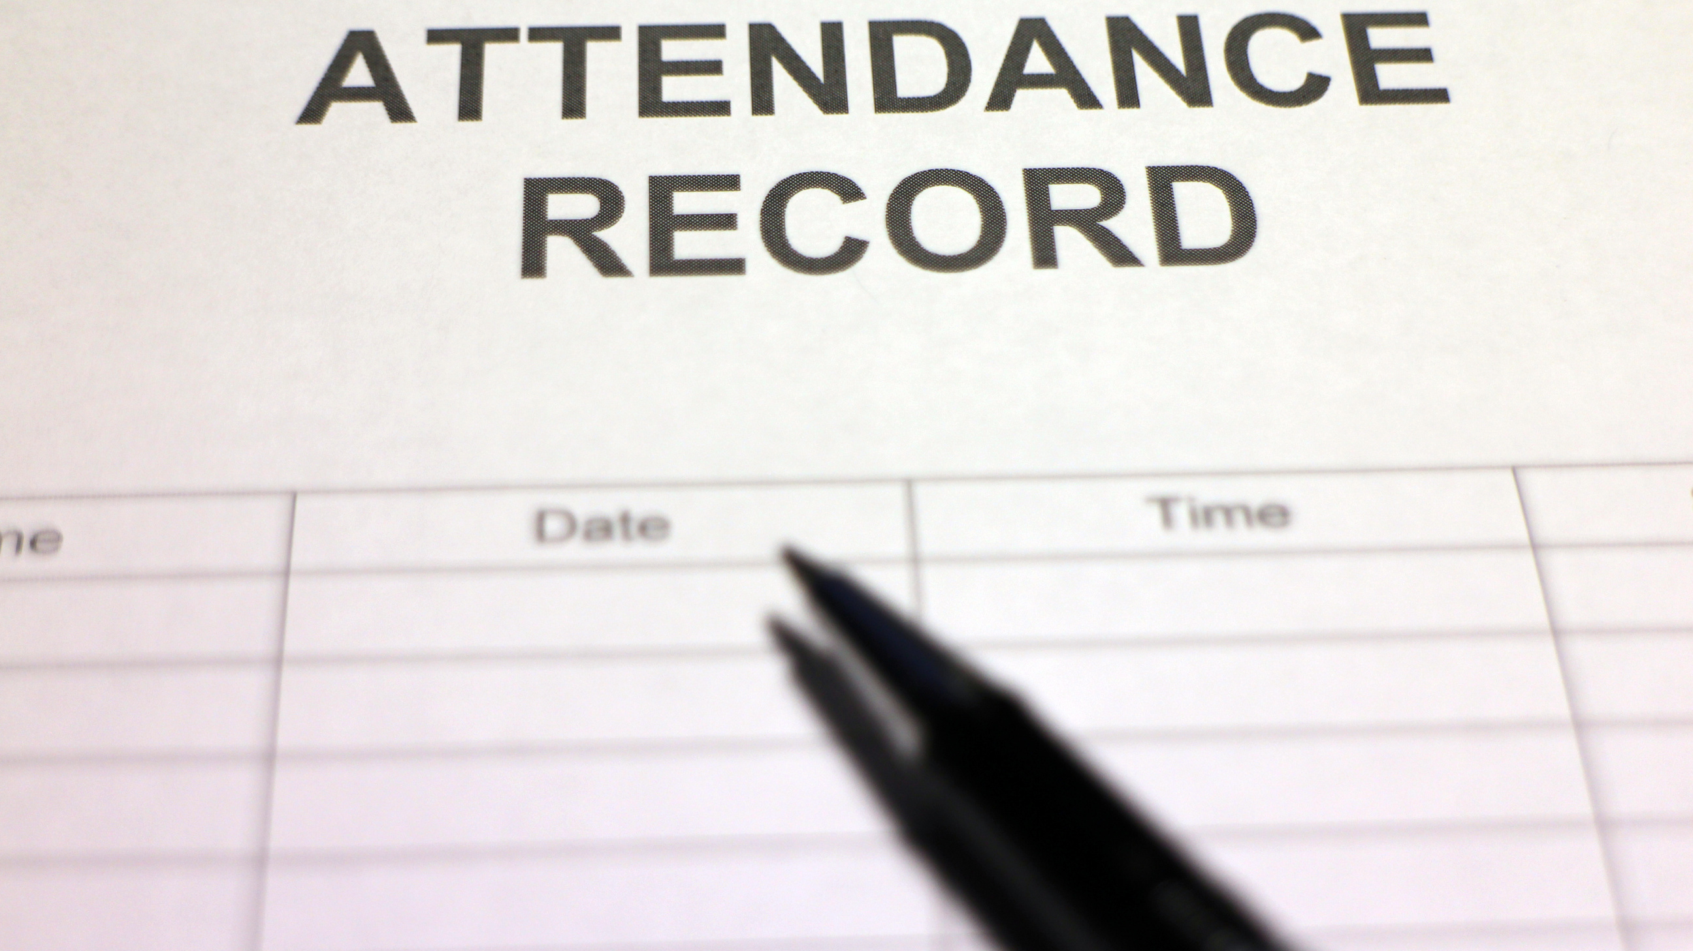
There has been a decline in student attendance in recent times.
We are asking all parents to arrange appointments, driving lessons etc outside of school hours where possible.

Slide 8
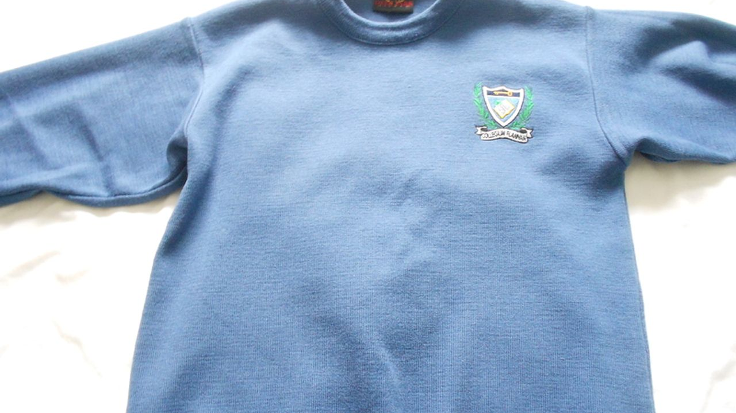
Uniform
Full uniform must be worn
Boys must be clean shaven
No facial piercings
Black shoes
Natural hair colouring

Slide 9
After school study
Spaces available
Mon - Tues 4.30 - 6.00 & 6.15 - 7.45
Wed - Fri 3.45 - 5.15 & 5.30 - 7.00
Cost: €3 a day paid online in 5 weekly payments
For more information e-mail michael.kelly@stflannanscollege.ie

Slide 10
Mobile Phone Usage
Huge issue at present
Please speak with your son/daughter regarding the use of their mobile phone
e.g. taking photos of their teacher in class &uploading to social media
e.g. when out socialising taking and sending photos of themselves & their classmates to their teachers on Teams

Slide 11
ANY QUESTIONS OR QUERIES
PLEASE DON’T HESITATE TO
APPROACH US
AFTER THIS PRESENTATION

