Slide 1
6th year Progression Options
Guidance Department
1
Notes:
1

Slide 2
Outline of Session
Choosing Careers & Courses
Skills Shortages
Points system
Applying to CAO- what, where, when, how
Allocation & Acceptance of Places
SUSI, HEAR & DARE
Other options (PLC, Apprenticeships, Studying Abroad)
How you can help
Useful Websites

Slide 3
Choosing a Career
Research options and make decisions by:
Assess Aptitudes, Skills & Qualities, Favourite Subjects, Hobbies, Career Interests, Values (eg. security, family, pay).
Talk to family members, guidance counsellor, teachers, present students, graduates, course co-ordinators.
Information- Open days, college websites & prospectus.
Explore options on Career websites
Consider skills shortages for the future.
Remain open minded – Be willing to consider courses outside of Limerick if financially possible.
Have a Plan B!
It is about making smart, informed decisions.

Slide 4
Choosing a Course
Compare:
Career focused vs. broad subject area (which will suit you?)
Course content : Subjects & electives (know what they are)
Class sizes
Opportunities for work placement & studying abroad
Assessment-Continuous, exams, projects, terminal exams etc.
College facilities, clubs and societies
Location/Travel/ Public transport
Overall Costs

Slide 5
Skills Shortages Ireland
Science - Chemists, Laboratory Technicians, Environmental Health Officer
IT - app developers, data analysts, software developers, IT support specialist, programmer, web design/developer, games designer, cyber security.
Engineering - biomedical, chemical, electrical, energy, mechanical, automation, quality, welder, toolmaker.
Business and finance - accountant, business intelligence analyst, risk and compliance professional, tax consultant, customer service representative.
Healthcare - doctor, nurse, pharmacist, optician, health manager, care assistant.
Hospitality - chefs, catering, waiting, Health & Safety Inspector/Officer
Construction – Most apprentices, Quantity Surveyor, Civil Engineer, Heavy Goods Vehicle Driver
Natural and social science professionals - scientist in food manufacturing, medical laboratory scientist.

Slide 6
“Minimum Entry Requirements”
ENTRY REQUIREMENTS -Must be satisfied before “points” are considered.
UL: Level 8: 2H5 & 4O6/H7 – English, Maths, 1 other language (for some, not all)
TUS (LIT): Level 8: 2H5 & 4O6/H7 Level 6/7: 5O6/H7.
LCFE: Pass Leaving Certificate
Specific Subject Requirements
Engineering(UL): H4 Maths
Veterinary Medicine(UCD): H5 Chemistry (plus 15hrs)
Business with French (UL): H4 French
Journalism & Digital Communications (UL): H4 English
If all Entry Requirements are met applicant is deemed ‘Qualified’ to apply and only then are points looked at.

Slide 7
Points System

Slide 12
CAO- Key Dates

Slide 15
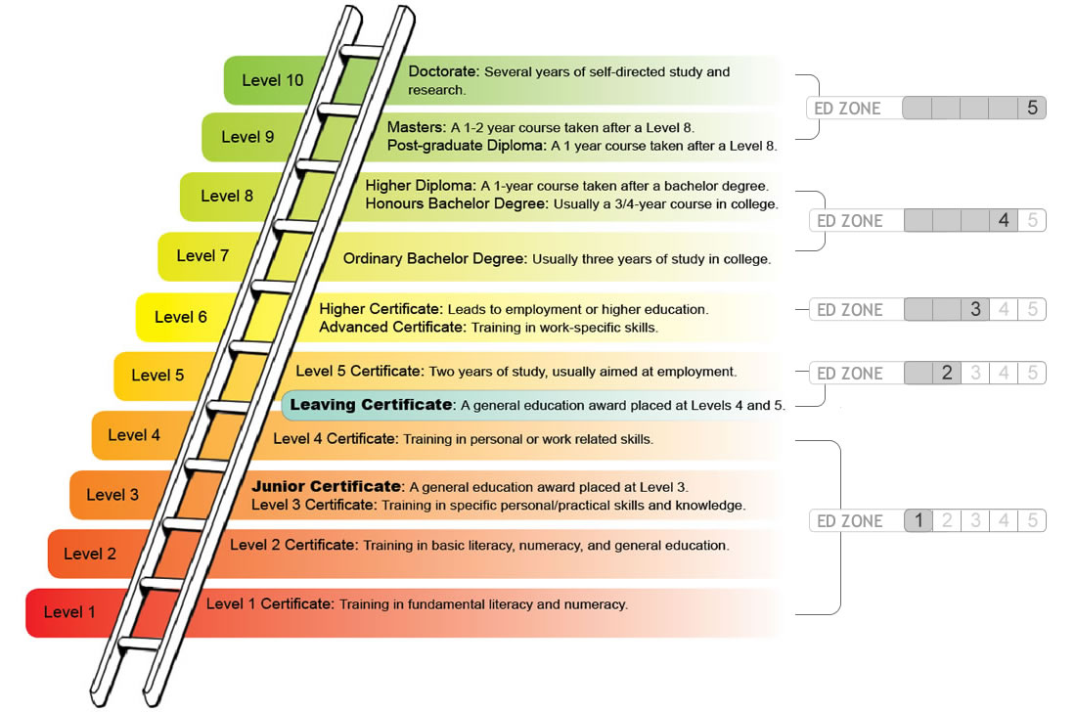

Slide 21
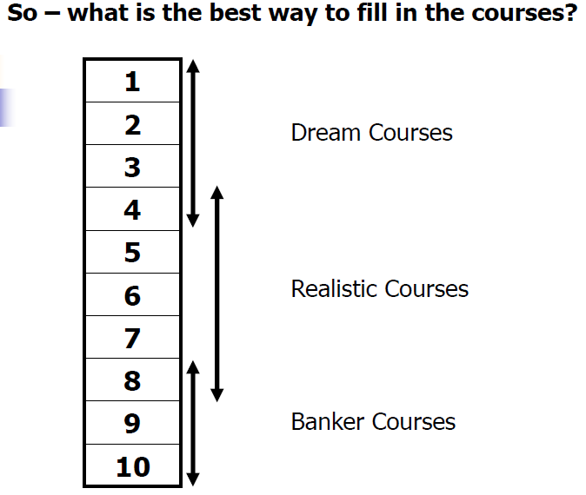

Slide 30
Common Errors
Not enough research into courses AND career
Listing courses in order of points instead of genuine preference
Underestimating / overestimating Leaving Certificate results
Targeting low point courses in hope of getting College place
Targeting Level 8 courses only and ignoring Level 7 & 6 courses thereby Ladder of Opportunity
Not considering courses outside certain geographic areas

Slide 32
Additional Supports: HEAR
The Higher Education Access Route (HEAR) is a college and university scheme that offers places on reduced points and extra college support to school leavers from low income families who are resident in Ireland.
www.accesscollege.ie
Information Sessions for HEAR & DARE will be held live in early Jan.

Slide 33
Additional Support: DARE
College admissions scheme which offers some places at reduced points and extra college supports to school leavers who, as a result of having a disability or specific learning difficulty, have experienced additional educational challenges in second level education.
www.accesscollege.ie
ALL students applying for DARE need to contact their guidance counsellor

Slide 34
Additional Supports: SUSI
SUSI is the central application system for grants for full time Higher Education. Not all colleges are included eg. Private Colleges
For reckonable income levels, all other info. regarding eligibility and to register for the grant for 2023 go to www.susi.ie
Apply from April - August. Earlier you apply, earlier you get it.
Can prepare accounts from 2022
Self employed: Full set of Accounts, Self Assessment Statement
PAYE Worker: P20 or P60
Unemployed: SUSI have direct link to Revenue
Monthly instalments Sept- May.

Slide 35
Scholarships
Sport
Discipline of study
Low family income
Disability/ special need
High Leaving Cert. points

Slide 36
Options other than CAO
PLC (Post Leaving Cert. course)
Apprenticeships (www.apprenticeship.ie)
Studying Abroad
On the job training (Army, Gardaí, Marines, E.M.T.)
Year out/ Travel/ Volunteering/ Work to earn &PLC combined

Slide 38
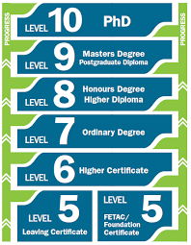
1 year Post Leaving Cert. (PLC) Route
Apply from February, Eligible for Maintenance Grant
Leaving Cert + Interview, maybe specific subject required
Progression possible to many HETAC Level 6, 7 and 8
Some colleges require specific PLC courses, others don’t mind which you do. Some require minimum number of distinctions. All are competitive.
Chosen by those who a) maybe young, b) perhaps didn’t get the points for course they wanted, c) financial reasons, d) confirm interest in specific area, e) hope of recognised qualification and employment after 1 year, f) alternative route to college

Slide 39
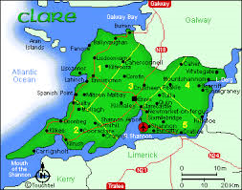
Local PLC providers
Ennis College of Further Education
Choose from Nursing Studies, Medical Secretary, Childcare w/ Special Needs, Community Health, Business Studies, Accounting Technician, Music, Food Science, Laboratory Techniques, Social Studies
Others providers in Co. Clare
Ennistymon, Lisdoonvarna, Kilrush
Limerick College of Further Education
Extensive range from I.T., Beauty, Culinary Skills, Emergency Care Personnel, Event Management, Fashion Design, Music Technology, Art Portfolio, Laboratory Techniques, and many more.

Slide 40
Practical Example
Year 1
Computer Systems & Networks, Level 5 in LCFE
Year 2
Advanced Computer Systems & Networks, Level 6 in LCFE
Year 3
Bachelors Degree in Computer Networks & Systems Mgt at TUS Level 8, 2nd year.
Note: For some third Level courses, the Level 5 course is specific. For others, any will do.

Slide 41
Studying Abroad
Europe (EUNICAS) UK (UCAS)
Degree Programmes taught through English in European & UK Universities
Especially popular for high pointed courses in Ireland
Veterinary Medicine, Medicine, Physiotherapy, Radiography, Dentistry, Pharmacy etc.
Things to consider:
Entry requirements (specific and general), Application process & deadlines, Travel, Fees, Cost of living.

Slide 42
Apprenticeships
7 Phases- 4 years
Phase 1 – With Employer
Phase 2 – In SOLAS Centre
Phase 3 – With Employer
Phase 4 – Institute of Technology
Phase 5 – With Employer
Phase 6 – Institute of Technology
Phase 7 – With Employer

Slide 43
Apprenticeships
Must find employer (personal contacts, SOLAS, advertisements) to take you on who must register with SOLAS within 2 weeks.
Potential apprentices join Employers on a regular basis. (Often after exam results) Employer must be approved by SOLAS, Employer registers apprentice (Phase 1) who then goes on a waiting list for Phase 2.
Rates vary from trade to trade Average Phase 2 Rate is €200.00 p.w. Average Phase 4th Year Rate is €475.00 p.w.
Big demand for Tool Makers, Jobs also for Refrigeration & Air Conditioning, Instrumentation, Electronic Security Systems.
www.solas.ie www.apprenticeship.ie www.apprenticeshipjobs.ie
Other Apprenticeships through ESB, Eir, Shannon Aerospace etc.

Slide 45
How you can help your son or daughter
(1) Encourage to attend school & participate
(2) Encourage to do homework to best of ability
(3) Take an interest in their school work
(4) Encourage to Revise, daily and at weekend
(5) Quiet place to study
(6) Exercise, eat well, sleep well
(7) Discuss their plans for next year & career

Slide 46
Important Websites
www.qualifax.ie (Courses)
www.careersportal.ie (Careers)
www.cao.ie (CAO Application)
www.eunicas.ie (Studying in Europe)
www.ucas.com (Studying in UK)
www.apprenticeship.ie (Apprenticeships)
www.susi.ie (Maintenance Grant)
www.studentfinance.ie (Other finance options)
www.accesscollege.ie (HEAR & DARE)

