Slide 1
Welcome to St. Flannan’s College
1st Year Information evening 2023-2024

Slide 2
Deputy Principal Ms. Grainne Lynch
Transition from Primary to Secondary
2.Practical issues – School Uniform/School Policies/Teams

Slide 3
Who To Contact
First Year Deputy Principal: Ms. Grainne Lynch
Grainne.lynch@stflannanscollege.ie
Year Heads:
1A-1E: Ms. Emer Murphy
emer.murphy@stflannanscollege.ie Phone Ext: 107
1G-1I: Ms Grainne Lynch (ACTING)
Grainne.Lynch@stflannanscollege.ie Phone Ext: 108

Slide 4
Who to Contact
1st Year AEN Coordinator:
Ms Annemarie McGann Phone Ext: 214
Annemarie.McGann@stflannanscollege.ie
Well-being and mental health concerns: Ms Brenda McMenamin Phone Ext: 111
Brenda.McMenamin@stflannanscollege.ie

Slide 5
The Role of the Year Head
Year Heads mentor all students in their year group, identify students needing care, and support students in difficulty (pastoral care role)
Ensures the year group follow the Code of Behaviour
Monitors lateness and absenteeism
Oversees academic progress of students.
Facilitates parental contact, meetings etc.
Liaises with AEN department

Slide 6
VSware App
Please download the app and turn on push notifications to ensure that you don’t miss any important school announcements/information
A lot of information is maintained here:
• Attendance
• Students’ timetables
• School reports (Christmas/Summer)
Any issues downloading the App please email:
Info@Stflannanscollege.ie

Slide 7
Absences & Punctuality
Absence requests must be sent via the VSware app
Parent App - Video - Parent sending an 'Absence Request' to the school using a desktop browser (vsware.ie)
Please submit absence requests before 8:30am
If your child is absent from school and has missed the AM registration, you will be notified via the app and asked to submit an absence note

Slide 8
Absences & Punctuality
Arriving Late / Leaving Early
• Students must sign in at main office if they are late in the morning. Parents are asked to log this on the App
• Students must sign out at the front office if leaving school early. Parents/Guardians must collect the student & sign them out at the main office. An absence request should be inputted on VsWare before the student is collected

Slide 9
Ms. Emer Murphy Year Head 1A-1E
School Journal
Homework
Organisation
Mobile Phones
Social Media

Slide 10
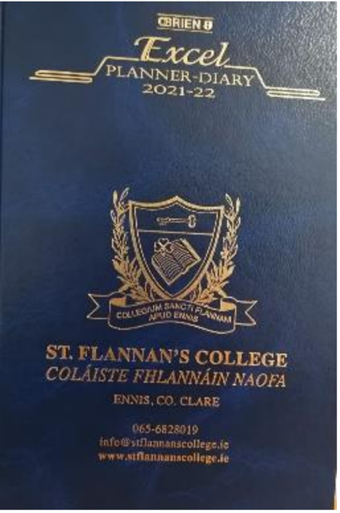
School Journal
Communicate with teachers via the student journal if there are on-going problems with homework.
Students are encouraged to enter all homework into journal. NOT JUST WRITTEN WORK
Please sign every week

Slide 11
Homework
Duration of study/homework time can vary for each student. If you have concerns over homework time/difficulty of h/w, please contact the Year head.
Prepare a study/homework plan
Study skills to take place soon
Please note Christmas Examination Results are based on continuous assessment

Slide 12
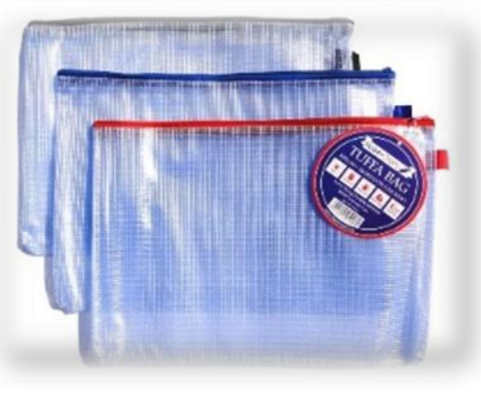
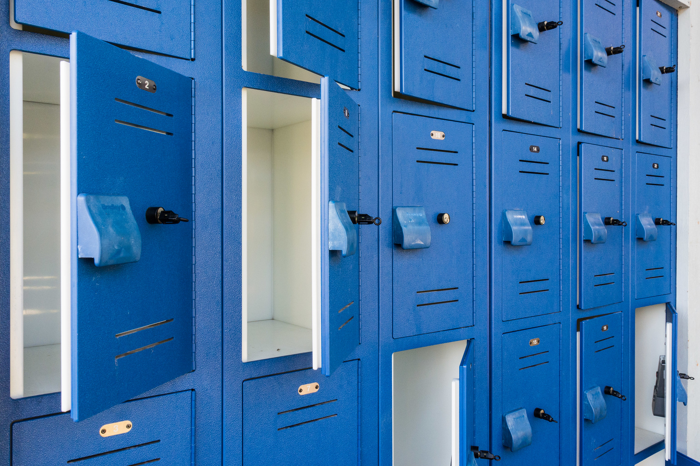
Organisation
• Copy of timetable at home
Good locker practice
Labelling of books and clothing
Lost Property: Box outside the main office and PE area
This Photo by Unknown author is licensed under CC BY.

Slide 13
Mobile Phones
Mobile Phone usage policy in St. Flannan’s College:
Phones may be used before school, during small break and lunch.
Teachers may encourage the appropriate use of mobile phones in pursuit of learning, in classrooms and other learning settings within the school
If a phone is misused by a student, the phone will be taken from the student and returned at the end of the day. A PNF is issued on the first offence and a detention thereafter

Slide 14
Social Media

Slide 17
Information from 1st Years
43% of 1st Years have been added to unwanted groups on Snapchat
35% of 1st Years have more than 200 friends on Snapchat
51% of 1st Years have their phone beside them at night
2 in 5 students say they wake up during the night to check messages on social media leading them to feeling constantly tired at school
This Photo by Unknown author is licensed under CC BY-NC.

Slide 18
Long ago, when our children came in home for the evening we knew they were safe
Now – with mobile phones that is no longer the case unfortunately!

Slide 19
Information for Parents
https://www.webwise.ie/category/videos/videos-for-parents/
Parenting Hub - ISPCC
Parental Controls - Parental Controls - Wayne Denner

Slide 20
Special Educational Needs
St. Flannan’s College

Slide 21
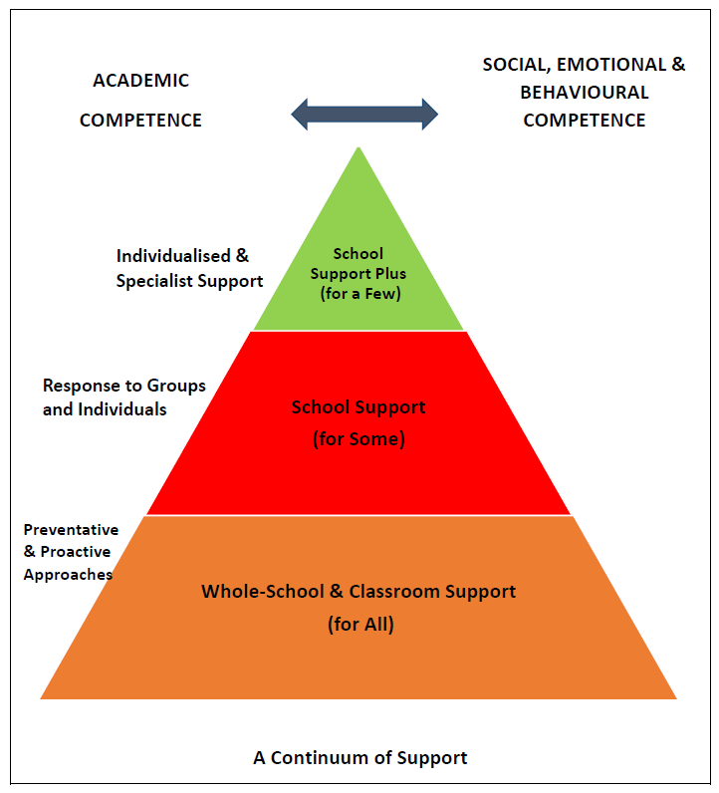
Continuum of Support
School Support Plus for a Few
Support for Some
Support for All

Slide 22
How do we know what AEN requirements our students have?
Information from Primary Schools.
CAT 4 Aptitude Tests.
Assessment Testing in English and Maths: PPAD-E, SFC Maths assessments.
Teacher observation and teacher referrals.
Parental input.

Slide 23
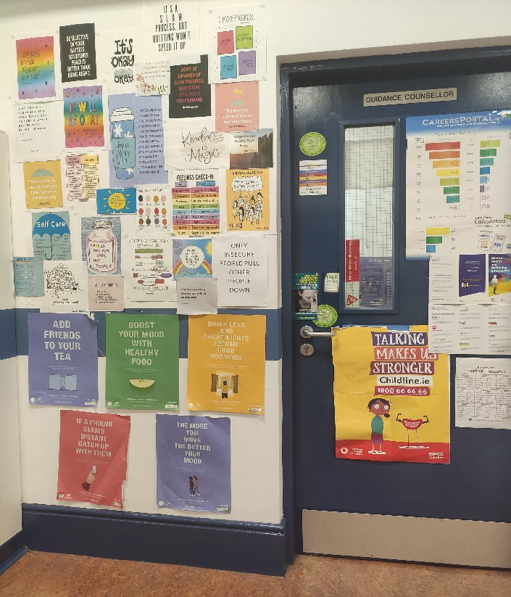
Guidance Department 1st year Guidance Counsellor is Ms McMenamin
The role of the Guidance Counsellor falls into three areas:
Educational Guidance
Vocational Guidance
Social & Personal Guidance
Ms McMenamin can offer support for personal or school related issues. Students may self-refer or they may be referred by their year head, class teacher or tutor. They can request an appointment by calling to her office.
Should any parents/guardians wish to contact the Guidance Counsellor please do so on 0656828019 ext. 111

Slide 24
RECOMMENDATIONS

Slide 25
RECOMMENDATIONS
Study Skills Webinar Series for Post Primary Students and Parents (PP)
DATE: Monday, 15th, 22nd & 29th January 2024 TIME: 7pm - 7.45pm VENUE: Online Via Zoom
Webinar 1: Monday, 15 January 7:00 – 7:45pm Webinar 2: Monday, 22 January 7:00 – 7:45pm Webinar 3: Monday, 29 January 7:00 – 7:45pm

Slide 28
FOLLOW US ON SOCIAL MEDIA
St Flannan’s College Official
Facebook
Twitter
Instagram

Slide 29
Reminder again who to contact
First Year Deputy Principal: Ms. Grainne Lynch
Grainne.lynch@stflannanscollege.ie
Year Heads:
1A-1E: Ms. Emer Murphy
emer.murphy@stflannanscollege.ie Phone Ext: 107
1G-1I: Ms Grainne Lynch (ACTING)
Grainne.Lynch@stflannanscollege.ie Phone Ext: 108

